Slide 3
SAMHSA’s Trauma-Informed Approach: Key Assumptions and Principles

Slide 4

Things to Remember
Underlying question =
“What happened to you?”
Symptoms =
Adaptations to traumatic events
Healing happens
In relationships
Video: Power of Empathy
Notes:
The underlying question is not “What’s wrong with you?” but “What happened to you?”
What are often called symptoms are actually adaptations to traumatic events.
Healing happens in relationships.
Power of Empathy (Video - Brene Brown) available at https://www.youtube.com/watch?v=1Evwgu369Jw

Slide 5
What is Trauma?
Individual trauma results from an event, series of events, or set of circumstances that is experienced by an individual as physically or emotionally harmful or life threatening and that has lasting adverse effects on the individual’s functioning and mental, physical, social, emotional, or spiritual well-being.
Notes:
This framework for understanding trauma was developed by a working group of researchers, practitioners, trauma survivors, and family members convened by SAMHSA.
It is important because it creates a framework for understanding the complex nature of trauma.

Slide 6
The Three E’s in Trauma
Events
Experience
Effects
Effects of trauma include adverse physical, social, emotional, or spiritual consequences.
Events/circumstances cause trauma.
An individual’s experience of the event determines whether it is traumatic.
Notes:
The focus on events places the cause of trauma in the environment not in some defect of the individual. This is what underlies the basic credo of trauma-informed approaches: “It’s not what’s wrong with you, but what happened to you.”
The focus on experience highlights the fact that not every child or adult will experience the same events as traumatic.
The identification of a broad range of potential effects reminds us that our response must be holistic—it’s not enough to focus on symptoms or behaviors. Our goal is to support a child to learn and grow or an adult to live a satisfying life.

Slide 7
Potential Traumatic Events
Abuse
Emotional
Sexual
Physical
Domestic violence
Witnessing violence
Bullying
Cyberbulling
Institutional
Loss
Death
Abandonment
Neglect
Separation
Natural disaster
Accidents
Terrorism
War
Chronic Stressors
Poverty
Racism
Invasive medical procedure
Community trauma
Historical trauma
Family member with substance use disorder
Notes:
There is a very wide range of events that can potentially cause trauma.
Trauma can be caused by events that the individual doesn’t remember, such as events that occurred in early childhood.
Trauma can be caused by events that are well-intentioned and necessary, such as medical procedures.
Trauma can be caused by an event that didn’t happen to the person but to a group that he or she identifies closely with—as in slavery or the Holocaust or the genocide of the Native American people.
Over time, chronic stressors can accumulate to cause trauma.

Slide 8
Experience of Trauma
Experience of trauma affected by:
How
When
Where
How Often
Notes:
The individual’s experience of trauma may be profoundly affected by when, how, where and how often it occurs.
Trauma can result from a single devastating event, called single-episode trauma (sometimes called acute trauma), or it can result from multiple traumatic events over time.
Most individuals served in the public system have complex trauma, which comes from experiencing multiple sources of trauma over a lifetime.
Trauma can be totally unintentional, as when an organization does harm through its procedures. For example, the routine practice of undressing for a medical exam can re-traumatize a person.
Systems can also unintentionally replicate the dynamics of an earlier trauma, causing re-traumatization.
Trauma can occur from hearing about, watching, or interacting with others who have had traumatic experiences.

Slide 9
Experience, cont.
Context, expectations, and meaning
Threat to life, bodily integrity, or sanity
Interventions
Humiliation, betrayal, or silencing
Subconscious or unrecognized
Notes:
The context, expectations, and meaning assigned to an event or circumstance may determine how it is experienced.
Trauma often includes a threat to life, bodily integrity or sanity and/or the feeling of being overwhelmed and unable to cope.
Even interventions that are necessary or life-saving may be experienced as traumatic (e.g., medical interventions or removal from an abusive home).
Humiliation, betrayal, or silencing may compound the traumatic experience.
The individual experience of trauma is not necessarily conscious or recognized either by the individual or by others, and it may include physiological as well as cognitive experience.

Slide 10

How can the same event be traumatic for one person and not for another?
Notes:
Ask participants to discuss why some events may be traumatic for one person but not for another.

Slide 11

Effect of Trauma
The effect of trauma on an individual can be conceptualized as a normal response to an abnormal situation.
Notes:
The effect of trauma on an individual can be conceptualized as a normal response to an abnormal situation.

Slide 12
Effect, cont.
Trauma can…
Cause short and long-term effects
Affect coping responses, relationships, or developmental tasks
Impact physiological responses, well-being, social relationships, and/or spiritual beliefs
Notes:
Trauma can have both short- and long-term effects, and impact may not be immediately recognized.
Trauma can affect an individual’s coping responses or ability to engage in relationships, or it can interfere with mastery of developmental tasks.
Trauma may affect an individual’s physiological responses, psychological well-being, social relationships, and/or spiritual beliefs.

Slide 13
Factors Increasing Impact
Early occurrence
Blaming or shaming
Being silenced or not believed
Perpetrator is trusted caregiver
Notes:
The younger the age when trauma occurs, the more likely the consequences. We will discuss why this is true—even when the individual has no memory of the trauma—when we briefly discuss how trauma affects the brain, or the neurobiology of trauma.
Shame and humiliation are core features of the trauma experience for many people. These emotions can be devastating and impede healing. One of the most important messages you can give a trauma survivor is that no matter what happened, it wasn’t their fault in any way.
Sometimes trauma survivors are intimidated by their perpetrators into not telling what happened. Other times, when they do try to talk about what happened to them, they are ignored or disbelieved. One of the most important things you can do for trauma survivors is to give them the chance to tell their stories. Healing starts when a person’s personal experience is heard and validated.
The impact of trauma is magnified when the perpetrator is a trusted figure—a relative, religious leader, coach, teacher, or therapist. This kind of trauma is often called “betrayal trauma” because the sense of betrayal can be so profound.

Slide 14
Adverse Childhood Experiences (ACEs) Affect Adult Health
ACEs have serious health consequences for adults:
Adoption of health risk behaviors as coping mechanisms (e.g., eating disorders, smoking, substance abuse, self-harm, sexual promiscuity)
Severe medical conditions (e.g., heart disease, pulmonary disease, liver disease, STDs, gynecologic cancer)
Early death
(Felitti et al, 1998)
Notes:
Adopting health risk behaviors can be a coping response to trauma—such as drinking alcohol to manage flashbacks.
This can put the person at greater risk and perpetuate the cycle of trauma and adversely affect their physical health and mortality.
Research has shown a connection between adverse childhood experiences (ACEs), or potentially traumatic experiences a person had before age 18, and health risk later in life.

Slide 15
ACE Questions:
While you were growing up, during your first 18 years of life:
1. Did a parent or other adult in the household often or very often… Swear at you, insult you, put you down, or humiliate you? Or Act in a way that made you afraid that you might be physically hurt?
2. Did a parent or other adult in the household often or very often… Push, grab, slap, or throw something at you? Or Ever hit you so hard that you had marks or were injured?
3. Did an adult or person at least 5 years older than you ever… Touch or fondle you or have you touch their body in a sexual way? Or Attempt or actually have oral, anal, or vaginal intercourse with you?
4. Did you often or very often feel that … No one in your family loved you or thought you were important or special? Or Your family didn’t look out for each other, feel close to each other, or support each other?

Slide 16
ACE Questions: Con’t
5. Did you often or very often feel that … You didn’t have enough to eat, had to wear dirty clothes, and had no one to protect you? Or Your parents were too drunk or high to take care of you or take you to the doctor if you needed it?
6. Were your parents ever separated or divorced?
7. Was your mother or stepmother: Often or very often pushed, grabbed, slapped, or had something thrown at her? Or Sometimes, often, or very often kicked, bitten, hit with a fist, or hit with something hard? Or Ever repeatedly hit at least a few minutes or threatened with a gun or knife?
8. Did you live with anyone who was a problem drinker or alcoholic or who used street drugs?
9. Was a household member depressed or mentally ill, or did a household member attempt suicide?
10. Did a household member go to prison?
(Felitti et al, 1998)

Slide 17
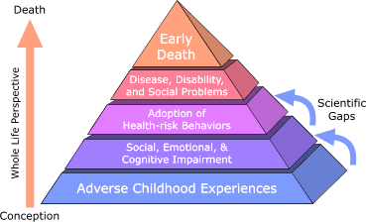
The ACE Study
  “Male child with an ACE score of 6 has a 4600% increase in likelihood of later becoming an IV drug user when compared to a male child with an ACE score of 0. Might heroin be used for the relief of profound anguish dating back to childhood experiences? Might it be the best coping device that an individual can find?”
  (Felitti et al, 1998)
Notes:
Perhaps one of the largest, if not the largest, ongoing health risk studies that established this relationship between trauma exposure and physical health is the ACE Study, organized by the CDC and Kaiser Permanente in San Diego, CA
Researchers surveyed more than 17,000 insured individuals from 1995-1997 about their history of ACEs.
The ACE Study uses the ACE Score, which is a count of the total number of ACEs respondents reported, to assess the total amount of stress during childhood.
Findings:
Childhood abuse, neglect, and exposure to other traumatic stressors (ACEs) are common.
Almost two-thirds of study participants reported at least 1 ACE, and more than 1 in 5 reported 3 or more ACE.
The short- and long-term outcomes of these childhood exposures include a multitude of health and social problems.
As the number of ACEs increases, the risk for the types of health problems on the previous slide increases in a strong and graded fashion and with that a direct, negative impact on mortality and longevity.
“Is drug abuse self-destructive or is it a desperate attempt at self-healing, albeit while accepting a significant future risk?” (Felitti et al, 1998)
I’m going to read you the questions asked in the ACE study to determine childhood exposure to traumatic stressors. You may wish to make a note of any questions that stand out to you as you think about these events in your own life and in the lives of the people you serve.

Slide 18

Facts on Traumatic Stress and Children with Developmental Disabilities National Child Traumatic Stress Network
Adapted Trauma Treatment Standards Work Group
This project was funded in part by the Substance Abuse and Mental Health Services
Administration, U.S. Department of Health and Human Services

Slide 19
Facts on Traumatic Stress and Children with Developmental Disabilities From the National Child Traumatic Stress Network Adapted Trauma Treatment Standards Work Group Subgroup on Developmental Disability
Margaret Charlton, PhD,
Matthew Kliethermes, PhD, Brian Tallant, MS,
Anne Taverne, PhD, Amy Tishelman, PhD,
Dr. Charlton is from the Aurora Mental Health Center. Dr. Kliethermes is from the Greater St. Louis Child Traumatic Stress Program. Mr. Tallant is from the Aurora Mental Health Center. Dr. Taverne is from the Child Trauma Treatment Network—Intermountain West. Dr. Tishelman is from Children’s Hospital, Boston.
National Child Traumatic Stress Network
www.NCTSNnet.org
2004
The National Child Traumatic Stress Network is coordinated by the National Center for Child Traumatic Stress, Los Angeles, Calif., and Durham, N.C.
This project was funded in part by the Substance Abuse and Mental Health Services Administration (SAMHSA), U.S. Department of Health and Human Services (HHS). The views, policies, and opinions expressed are those of the authors and do not necessarily reflect those of SAMHSA or HHS.

Slide 20

•Individuals with developmental disabilities are at increased risk for abuse as compared to the general population (Gil, 1970; Mahoney & Camilo, 1998; Ryan, 1994).
• Goldson, 2002 reports maltreatment among children with disabilities:
• Individuals with disabilities are over four times as likely to be victims of crime as the nondisabled population (Sobsey, 1996).
• Sixty-four percent of the children who were maltreated had a disability. The most common
disabilities were behavior disorders, speech/language, learning disability, and mental
retardation. The most common type of maltreatment was neglect. Children with mental
retardation were the most severely abused. Children with communication disorders were
more likely to be physically and sexually abused (Sullivan & Knutson, 1998).
• Five million crimes are committed against individuals with disabilities each year in the United States (Petersillia, 1998).

Slide 21
Individuals with disabilities are 2-to-10 times more likely to be sexually abused than those without disabilities (Westat Ind., 1993).
One of 30 cases of sexual abuse or assault of persons with developmental disabilities is reported as opposed to one of five in the nondisabled population (James, 1988).
Even when the abuse is reported, the charges are rarely investigated when the victim is disabled (Senn, 1988).
Victims typically have difficulty accessing appropriate services (Sobsey & Doe, 1991).

Slide 22
Risk of abuse increases by 78 percent due to exposure to the "disabilities service system“ alone (Sobsey & Doe, 1991).
Immediate family members perpetrate the majority of neglect, physical abuse, and emotional abuse. Extraf amilial perpetrators account for the majority of sexual abuse (Sullivan & Knutson, 2000).
Sexual abuse incidents are almost four times as common in institutional settings as in the community (Blatt & Brown, 1986).
• Ninety-nine percent of those who commit abuse are well known to, and trusted by, both the child and the child's care providers (Baladerian, 1991).

Slide 23
Special Characteristics of the Population that May Influence the Incidence of Trauma
Abuse and neglect have profound influences on brain development. The more prolonged the abuse or neglect, the more likely it is that permanent brain damage will occur. Not only are people with developmental disabilities more likely to be exposed to trauma, but exposure to trauma makes developmental delays more likely.

Slide 24
People with developmental disabilities are
trained to be compliant to authority figures;
dependent on caregivers for a longer period of time for more types of assistance than a nondisabled child, and they are dependent on a larger number of caretakers;
often unable to meet parental expectations;
isolated from resources to whom a report of abuse could be made;
sometimes impaired in their ability to communicate;
sometimes impaired in their mobility;

Slide 25
more likely than other children to be placed in residential care facilities;
sometimes more credulous and less prone to critical thinking than others, which may result in it being easier for others to manipulate them;
often not provided with general sex education, and caregivers may feel that people with developmental disabilities are asexual, although
  for people with mild to moderate mental retardation sexual development and sexual interest occur at approximately the same age as the normal population (Tharinger, 1990), and
  precocious puberty is 20 times more likely to occur in persons with developmental disabilities than in the normal population (Siddigi, 1999); and
viewed negatively by society, which may label them as “bad” because they are different or may view them as less than human.

Slide 26
People with developmental disabilities may also experience
cognitive and processing delays that interfere with understanding of what is happening in abusive situations, and
feelings of isolation and withdrawal due to their differences, which may make them more vulnerable to manipulation because of their increased responsiveness to attention and affection.

Slide 27
Possible Reasons for a Higher Incidence of Mental Illness for Clients with Developmental Disabilities Than the General Population
(Avrin, Charlton, Tallant, 1998)
It is more difficult to cope with normal life stressors given the limited resources the client has available.
There is increased vulnerability to abuse in the home, since these children are often very difficult to raise and place a high level of strain on the family.
These children are more vulnerable to abuse in the community because of their poor judgment and lack of self-protective skills.
An additional stressor for the higher functioning clients is awareness of their intellectual deficits. They have many grief and loss issues associated with their functioning problems.
People with developmental disabilities experience greater difficulty in getting help for mental illness due to communication and processing problems.

Slide 28
Trauma in Adults: Mental Health, cont.
Clients with histories of childhood abuse
Earlier first admissions
More frequent and longer hospital stays
More time in seclusion or restraint
Greater likelihood of self-injury or suicide attempt
More medication use
More severe symptoms (Read et al, 2005)

Slide 29

Notes:
In a juvenile facility in Florida, the director understood that bedtime was a scary time for many of the girls. Whether they had been abused or witnessed violence in the home, night time was frightening. Thinking creatively on what could make a difference, the director utilized the talent of an officer and had him paint each cell to make them comforting. Simple paint and blankets did much to reduce fear and decrease anxiety at bedtime.

Slide 30
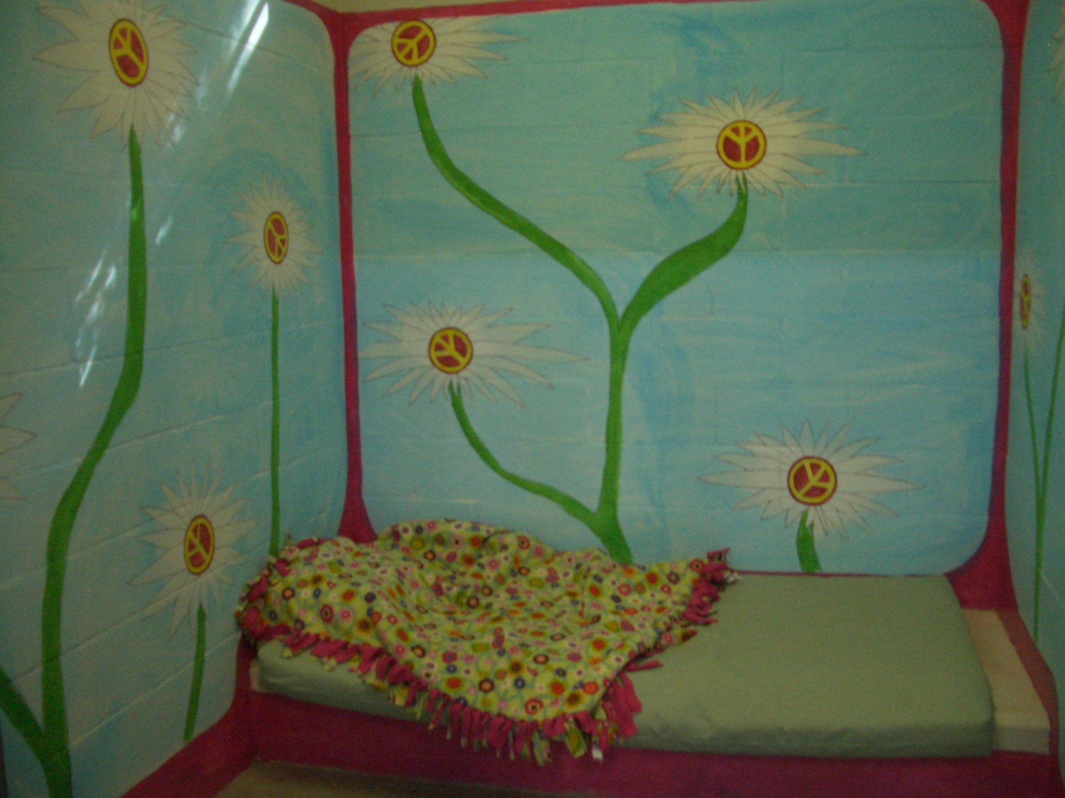

Slide 31


Slide 32


Slide 33
I've learned that people will forget what you said, people will forget what you did, but people will never forget how you made them feel.
~ Maya Angelou

Slide 34
Contact Information
Joan Gillece, PhD
SAMHSA National Center for Trauma Informed Care
Joan.gillece@nasmhpd.org
703-682-5195

