Slide 1
Building Effective Advocacy: Thoughts and Strategies
Charles Moseley
Rhode Island Developmental Disabilities Council
Annual Meeting
October 15, 2016

Slide 2
Questions
What opportunities are available for the Council and family groups to influence policy and practice?
How are effective movements created?
What strategies work to remove barriers and stimulate positive change?
What has moved the needle

Slide 3
Consent Decree Opportunities for Family Involvement and Support
Provisions ensuring:
Family involvement in person-centered career development planning in school, during transition and in adult services
Individuals and families receive information needed to make meaningful informed choices regarding services and supports
Benefits Plans detailing the impact of earned income on the person’s public benefits (IV)
Families have an active role in the SIS administration process (IV)

Slide 4
Consent Decree Opportunities: Additional Provisions Require
A transition planning process that provides youth and families with information and opportunities to experience Supported Employment and trial work periods (VIII).
  An Outreach Education and Support program for individuals and families to provide opportunities to learn of the benefits of integrated day services.
The provision of support for personal networks, family-to-family and peer-to-peer programs to link families and individuals in segregated programs with those receiving integrated employment and day supports

Slide 5
Consent Decree Opportunities
Employment First Task Force with parent and family representatives (among other stakeholders)
  Meet with the Monitor quarterly discuss barriers to CD implementation
  Meet with relevant state officials quarterly to discuss barriers to CD implementation
  Produce policy recommendations
  Have an active role in providing in-reach, outreach, education, transition, and linkage to individuals in facility-based sheltered workshops, day programs, and secondary schools.

Slide 6
Consent Decree Provisions Require the State to:
Implement incentives to encourage transition to integrated settings through the use of public-private partnerships with persons with I/DD, family members, employers, employment providers, and community organizations.
Develop and publicize its oversight process and mechanisms for individuals with I/DD, their families, service providers, and advocates to file complaints and have their concerns addressed in a timely manner.

Slide 7

Consent Decree Provides Goals and Framework
The Consent Decree sets clear goals and expectations for the
  full inclusion of people with DD in society,
  full access to supports people with disabilities need to be employed in integrated, community jobs at competitive wages, and
  full access to the assistance necessary to enable people to participate in the mainstream of community life.
It provides a list of actions that the state is required to take regarding the funding, the structure and the functioning of the service delivery system
It provides a comprehensive framework that is designed to establish enduring system change through an open and continuous dialog among:
  Families, people with disabilities and advocates
  State agency representatives
  Providers
DD System

Slide 8
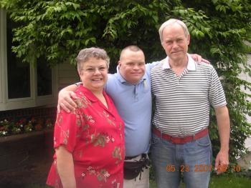
But, it doesn’t create the coalitions to ensure needed advocacy takes place
Self-advocacy for people with disabilities
Family advocacy to support family caregivers
Stakeholder organization to focus on key issues of quality, funding, self-determination and system support
Provider advocacy

Slide 9


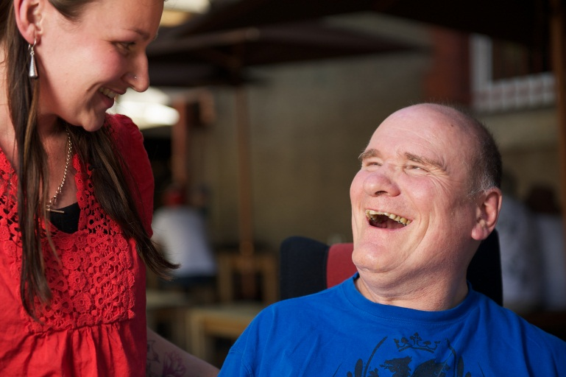
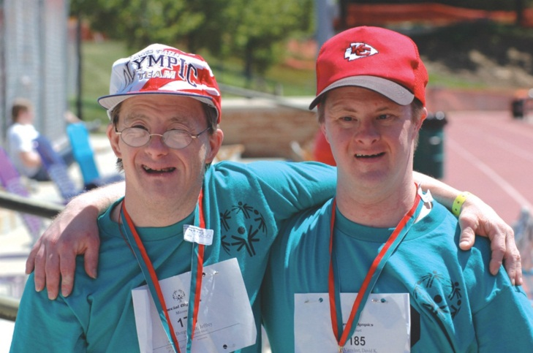
How do you bring about change?
How do you work with parents and others to enable them to become effective advocates for their children and themselves?

Slide 10
Effective Coalition Building Can Begin in a Number of Ways
Long term commitment
Careful planning
Development of coalitions and partnerships
Strategic meetings with key players who influence the design, funding, and delivery of services
Research into best and promising practices
Development of goals, plans and strategies
Individual action

Slide 11
7 Principles for Making Change:
Know Your Values
Develop an agenda for change
Understand the Structure and Functioning of Systems
    Know Your Facts
    Understand Financing
Know the data, what it means and how to use it
Build relationships and develop partnerships
Build Coalitions
Identify Issues: Set an Agenda Based on What People Need and want
Organize Task Groups to focus on key issues
Understand the Perspective of Those who Resist Change
Develop effective communication strategies
Make it Work: Select effective approaches for bringing about change
Cultivate leadership – develop a network of leaders

Slide 12
Mission Values and Goals
Be clear about what you want to accomplish
Identify the goals and the non-negotiables –
The things you want to accomplish and the actions that need to be taken to prevent your fears from becoming realized.
Philosophy is easy to agree on -
Be prepared to move from theory to practice, from hopes and dreams to the very real decisions that must be made to enable families to access support, help people get jobs

Slide 13

In theory, theory and practice are different
In practice, they are the same
Yogi Berra

Slide 14
The National Agenda on Supports to Families, 2011
The overall goal of supporting families, with all of their complexity, strengths and unique abilities is so they can best support, nurture, love and facilitate opportunities for the achievement of self-determination, interdependence, productivity, integration, and inclusion in all facets of community life for their family members.

Slide 15
Key Steps in establishing a family support coalition -

Slide 16
Values, Decisions and Evidence
We want to make decisions based on evidence, on information that affirms that one approach is actually better than another, has better outcomes
But some decisions must be based on human and civil rights.
We don’t need to data to tell us that people with disabilities are entitled to
  fully access employment and community services,
  Participate in community activities
  Live with their friends and families
  To go to school, attend classes and graduate with their friends
It important to be able to separate decisions that must be made on the basis of data from those that reflect the right thing to do.

Slide 17
Understanding System Structure, Functioning and Characteristics
Formal and Informal Systems of Support
Structure
  Different systems have different designs
  System Separation
  Funding Separation
Operation
Finance, Eligibility and Criteria for Service Provision
Decision Making
Language and Philosophy

Slide 18
Know How the System is Financed
Take time to understand the complexity of Medicaid, Medicare, private insurance.
Plot out how different systems are funded.
Follow the money, follow the responsibility.
Develop an understanding contract relationships between the state or funding agency and the provider.
Find out who knows the answers and the system

Slide 19
Develop the Capacity to Support Education and Training
Becoming a source for education and training provides excellent opportunities for bringing people, all people together
  Collaboration and coalition building
  Problem solving
  Providing advice and assistance
Create and support opportunities for training, more training, and still more training.
Values – include everyone

Slide 20
Build Credibility, Know Your Facts!!
Identify Key Issues, strengths and needs
Use Familiar and Credible Sources
Use Data to Back up Your Points
Be Consistent and Concise
Give credit to positive actions and changes

Slide 21
Organize a Task Group
It is important to know yourself and your own values, but if you are going to work closely with others, you must know, understand and accept their values as well.
  DD Act Work Group
  Division Work Group
  System Planning
Understand the perspectives of those who resist change

Slide 22
Why do people resist change?
The age old question
  Personal Reasons
  Resistance to changing other priorities
  Professional Reasons
  Lack of Skill at Bringing about Change
  Power
  Economic Reasons
  Bureaucratic Reasons – defending the professional establishment
  Donald Schon – Reflective Practitioner

Slide 23
Develop an Agenda
Develop an agenda for change: If you don’t have your own agenda, someone will force you to accept theirs.
Set the agenda or contribute to the development of one that is set by others
Have a clear set of activities you want to accomplish, practices to change or legislation to be introduced.
Define the language and direction of change.

Slide 24
Understanding the Process of Change: What Works
A Planned Strategy to bring about change.
Conceptualizing change as the development of a long-term capacity to support individuals in their own communities
  People with disabilities and others with similar needs
Building the capacity to support people with the most intensive needs helps everyone

Slide 25
Effective Collaboration
Involving people with disabilities and families in discussions and activities, from the beginning
Developing new partnerships with providers around self-determination and,
Reach across disability provider and family groups to pull together representatives and stakeholders to work toward a common agenda.

Slide 26
Select the Approach that Best Fits the Situation
Implementation through system-wide initiative or reorganization
Implementation through pilot projects
Making change one person at a time, building capacity around individuals or key services

Slide 27
Make it Work:
Use existing opportunities
Be aware of the effect of personal style and presentation
Winning the battle and losing the war
Whether to ask for permission
or beg for forgiveness
Develop good personal relationships with others

Slide 28
Stamp-in Change
Work to include principles of self-determination, family support, staff training, person-centered thinking in
  Legislation,
  Regulations,
  Policy,
  Planning, and
  System Redesign
  Activities
Common Purpose – Lisbeth Schorr

Slide 29

Leadership - Making it Happen
Room for many leaders
Develop strength through the involvement of others
Organizing
Mutual support

Slide 30

Sustaining Services
Families are
the long term care system
for people with
developmental disabilities.

Slide 31
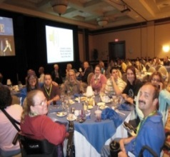
Stakeholder Engagement is Critical –
A seat at the table in policy development – not just testimony at a forum.
Ongoing participation – reviewing policies and deliberating together
Make materials understandable. Have families self advocates review them before they go out.
Make transportation and respite available so people can participate
Involve stakeholders in implementation –
  Consider contracting with family and/or self advocacy groups to mentor, collect data on what is and is not working, provide information (AZ contracts with the Parent to Parent information Center)
Involve stakeholders in quality oversight

Slide 32
What Families Say They Need to Hear
Vision and Values – A clear focus on improving services and supports - a purpose beyond “coordinating care and reducing costs”
Commitment to key outcomes
  Support to families
  School to work transition
  Competitive employment
  Self-direction – control over services & budget
  Small, innovative providers (run by families) in their community will continue
Commitment to collaborate with consumer and family groups & associations.

Slide 33
What’s Important to Families
Access to Services
Transitioning from school to adult life – a real job with needed supports
Access to family and individual directed supports that are flexible and adequately funded
Outcome based services – resulting in a job and a happy life with friends, family, - a valued role in the community
Continuity – services that will be present through the person’s lifespan
Predictability

Slide 34

A word about Data
Get it, understand it and use it
Washington State DD Council
Key Sources
  NCI: System performance and individual outcomes
  StateData.org Umass/Boston: Employment and Day Services
  DD Services and Trends: University of Minnesota – Residential Services, Supports to Families
  State of the States: University of Colorado Coleman Institute – DD Services, costs and expenditures

Slide 35
Use Data: National Core Indicators: What does the Data Tell Us
NCI Surveys provide important data on the status and needs of families providing support
The need to provide adequate crisis supports to families
The need to find ways to provide useful information that can make a difference in their lives
The importance of facilitating access to preventive and other forms of health care
The significance of continued support at home for the self actualization of adults with ID/DD

Slide 36
NCI System Performance Measures (100+)
Individual Outcomes
Employment
Community Participation
Family Outcomes
Choice and Control
Access, community connections
Health, Welfare, System
Health and Welfare
Staff Stability
Choice & Decision making
Personal Relationships
Family Involvement
Information & Planning
Response
Respect for Rights
Medications
Safety
Service Coordination

Slide 37
Crisis/Emergency
Crisis Supports Provided if Requested (past year)
55% sometimes, seldom or never
44% sometimes, seldom or never

Slide 38
Health Prevention by Type of Residence

Slide 39
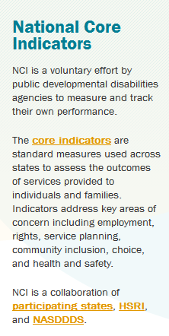
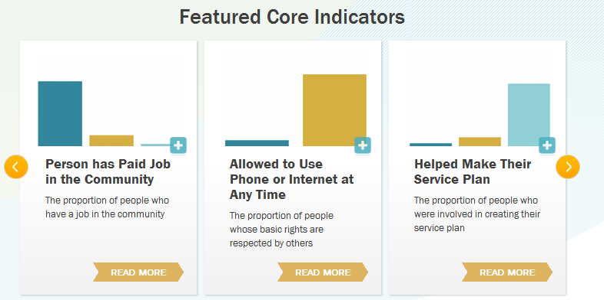
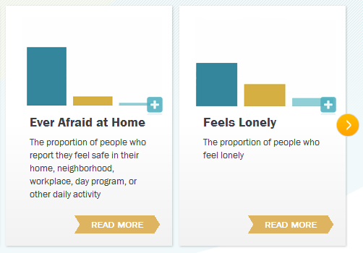
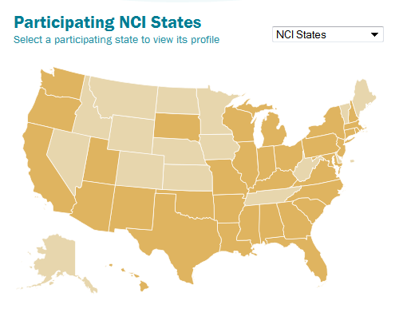
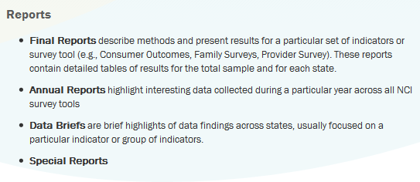
National
Core
Indictors
www.nationalcoreindicators.org

Slide 40










.
Funded by
In collaboration with

Slide 41
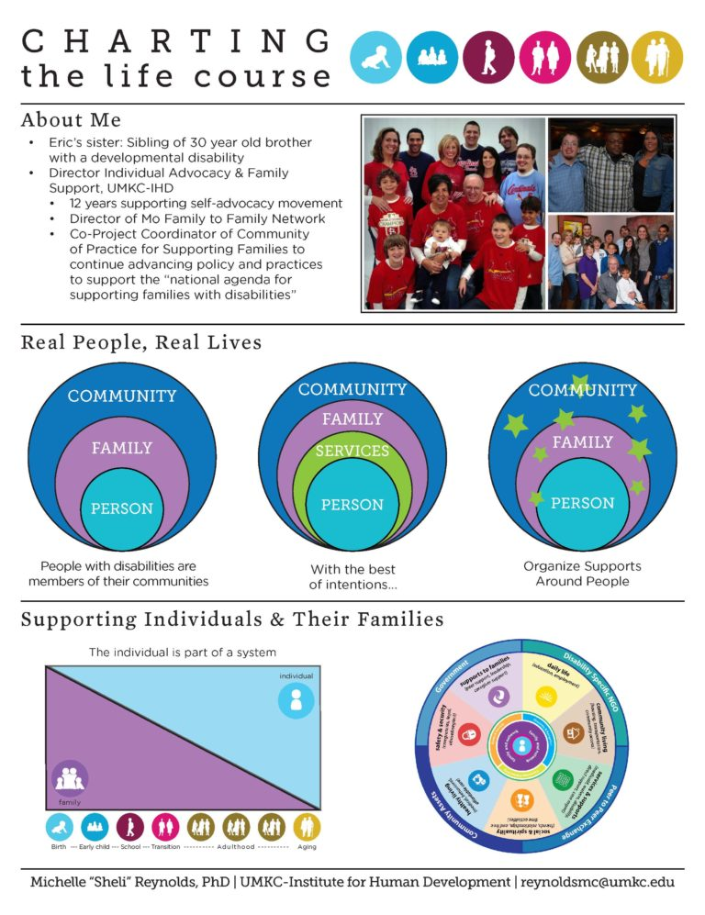
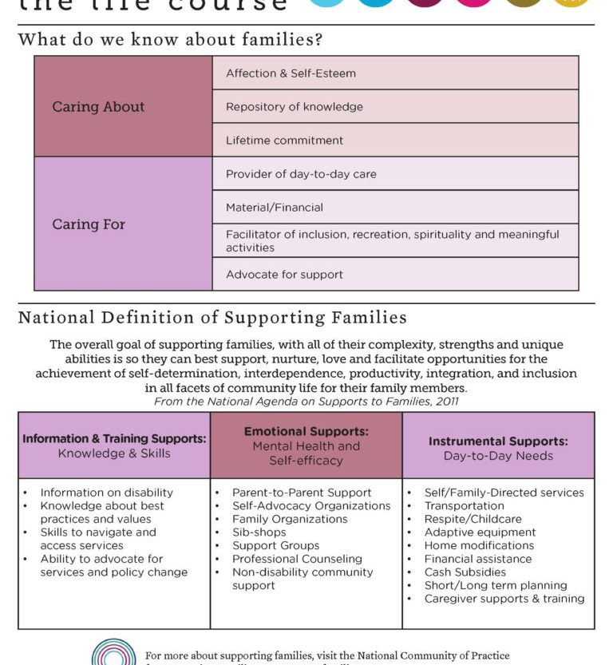
Building a Family Support Coalition: http://www.lifecoursetools.com/principles/
Notes:
The LifeCourse framework and its tools are designed to assist anyone to think about what they want in their life and to then break that down into manageable steps to moving towards that vision, regardless of communication style or abilities.

Slide 42
Final Thoughts
Focus on the individual
Focus on the Family
Focus on the people who provide support
Build capacity
Don’t let the system get in the way
Enjoy want you do
Its about relationships not events:

